Slide 2
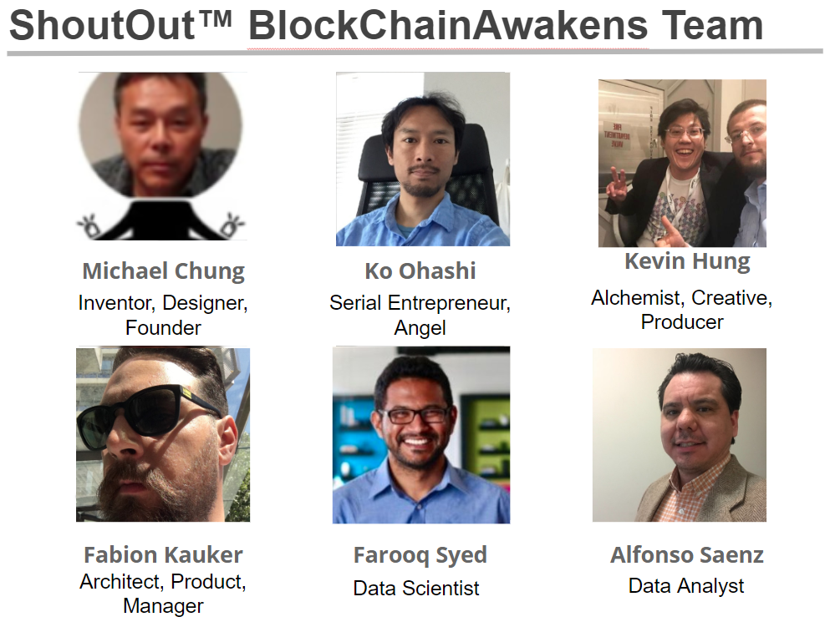
We came,
we met,
we built.
Linkedin ID:
chungmojo

Slide 3
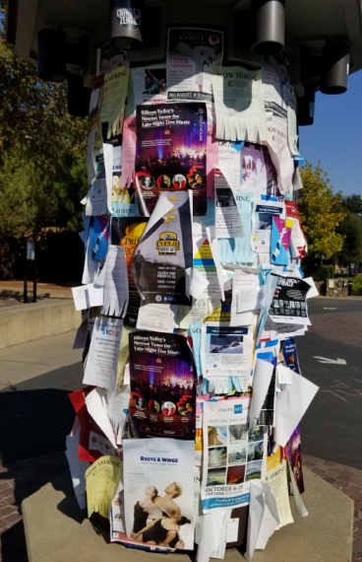
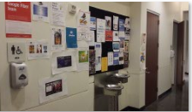
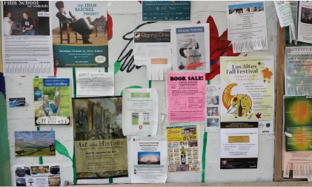
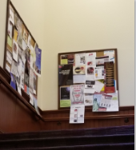
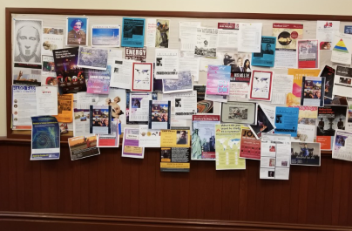
ShoutOut™ is the next generation bulletin board.
Problem to be Solved:
Paper based bulletin boards is an oxymoron in our digital age. We need a bridge with/and a digital version.
The Question:
Why does it persist, even at the the mostest-bestest-digitalest place in the universe: Google offices (LOL!); and Stanford, Philz, etc.
Actual Photos!

Slide 4





Why the need? A location/places based out-of-network communication channel – for colleagues, visitors, and marketers.
TM

Slide 5


In the last 100,000 years, the bulletin board technology has evolved from:
to
The State-of-the-Art.

Slide 6
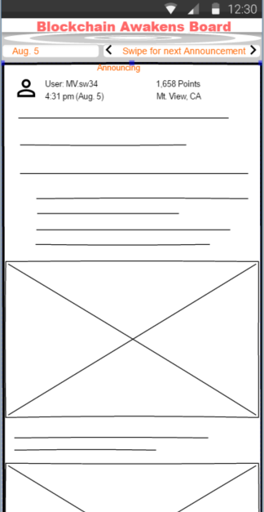
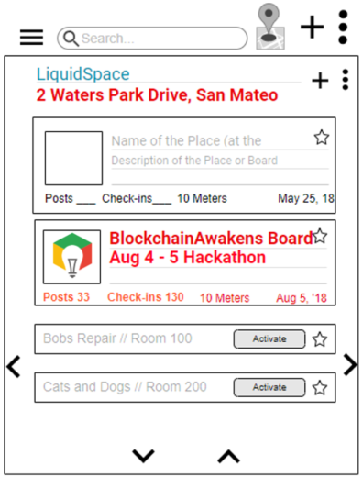
ShoutOut™: MVP UIs
Slack, fb

Slide 7
A) Marketers and ADs drive the token economy Opt-in ads on the Boards will be the primary fuel for the ShoutOut tokenization and tokenomics. “The total impact of advertising represented 19% of US GDP”. (Economic Impact of Advertising Study.) B) User behavior: Rewards, incentives, and credits Participating users are directly rewarded and incentivized. (BAToken, Steemit, etc.) C) ShoutOut platform – 100% smart & decentralized To be decentralized & smart contracts admin’d; the platform and devs earn fees from smart contracts; entire revenue model is smart contracts controlled.
BD: Physical + Virtualization + Tokenization
Users earn tokens with 2 behaviors:
1) Participation and contributions.
2) Engagement (opt-in) with the marketing adverts.
Social Impact: Breaking down the monopoly of content monetization.

Slide 8
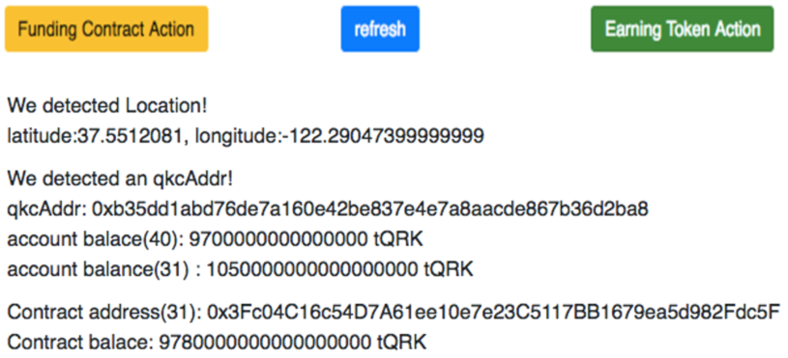
QuarkChain – 2 benefits for our POC
Demo Objectives and Purpose:
A) Technical POC of instant transactions on QuarkChain via strategy of aggregating all same geo-regional ShoutOuts on one QuarkChain shard.
1) Near instant if within the same shard.
2) 90 seconds if cross shards – use case: ShoutOut Boards are on one shard based on regions - North America, China, India, Central America, etc.
B) QuarkChain enables – Utility and Emotional benefits:
Two strong Value Propositions for ShoutOut.
Utility (Functional) – increased use cases, increase activities.
Emotional (User experience, brand hooks) – faster is greater satisfaction, and one of the biggest value drivers of any service.

